Slide 1
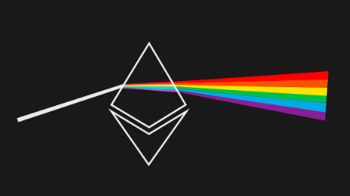
ClusterING ETHEREUM ADDRESSES
identifying patterns in transaction size, volume, and frequency
Notes:
Explain why I'm interested in Ethereum
Explain why clustering could be useful - motivation
Cosine similarity of clusters to each other?
Focus on potential applications
How can I predict illicit activity?

Slide 2

WHAT IS ETHEREUM?
open-source blockchain platform
decentralized payment network
platform for decentralized applications called smart contracts

Slide 3
THE FEATURES
Incoming | Outgoing | Miscellaneous
Transactions sent | Transactions received | Active months
Ether sent | Ether received | Ether balance
USD sent | USD received | Number of tokens used
Monthly transactions sent | Monthly transactions received | Smart contracts created
Monthly ether sent | Monthly ether received | Smart contract transactions
Monthly USD sent | Monthly USD received
Time between sent transactions Average Standard Deviation | Time between received transactions Average Standard Deviation
Notes:
s

Slide 4
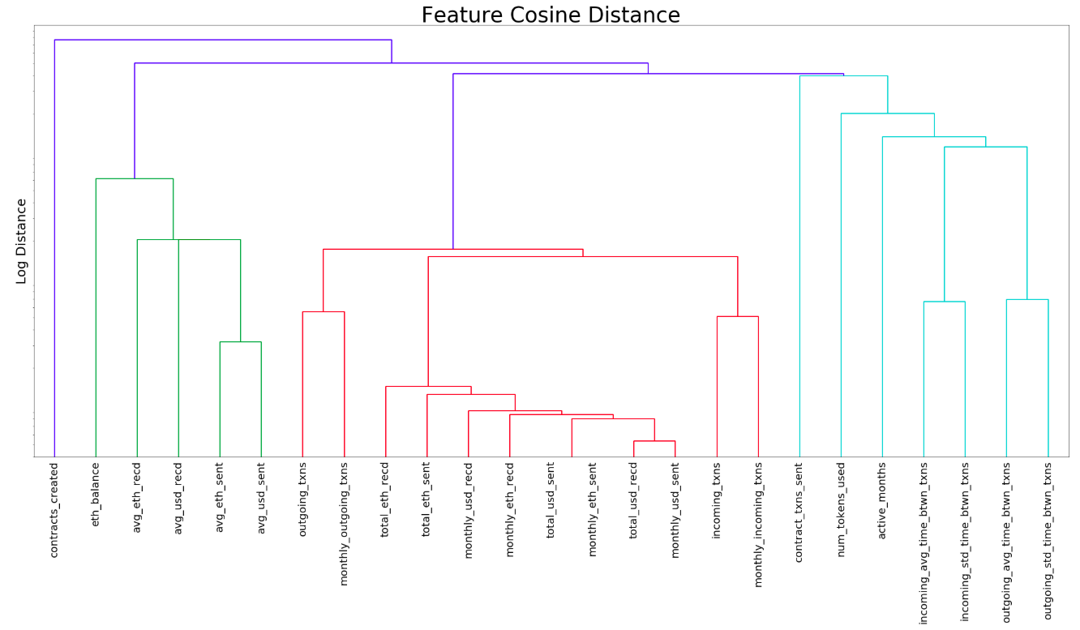
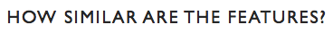

Slide 5
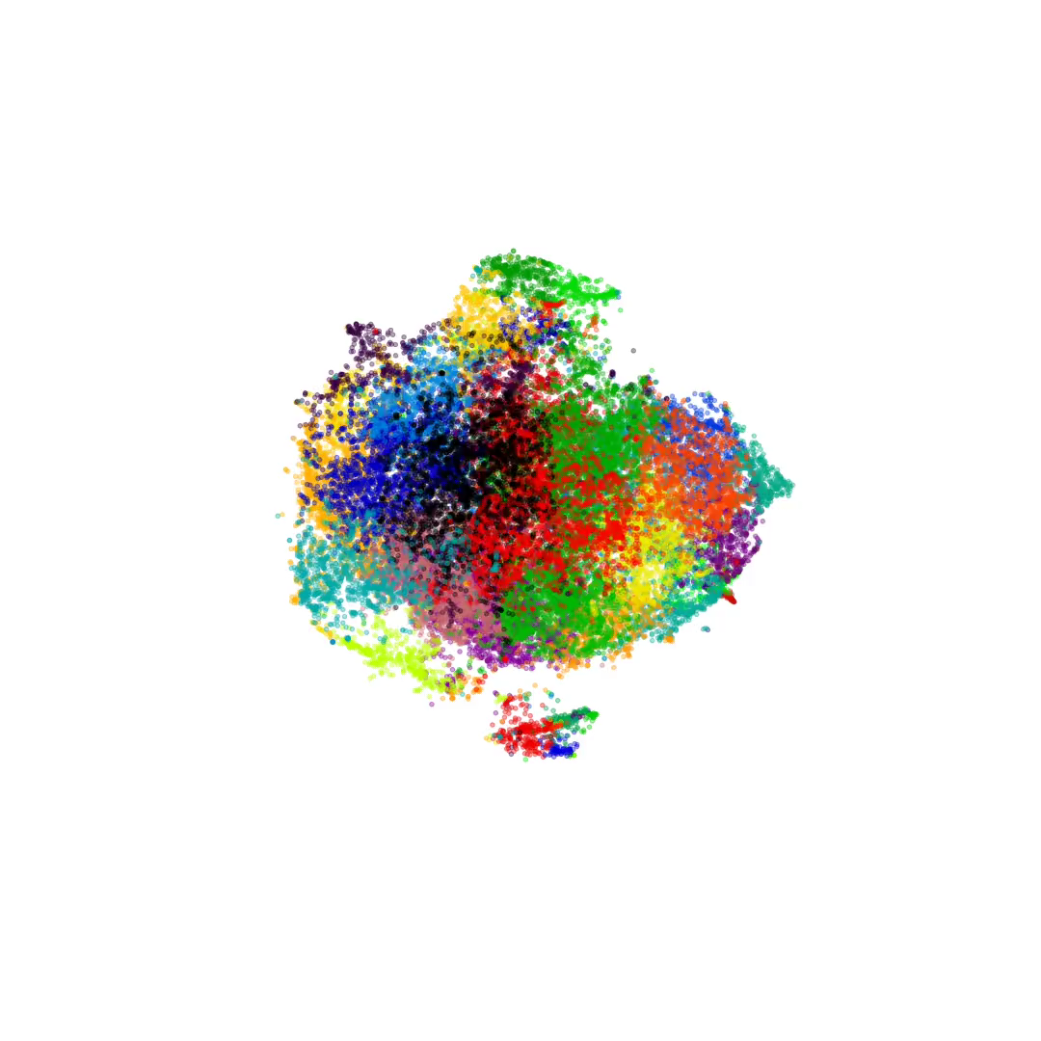
OPTIMAL NUMBER OF CLUSTERS IS ABOUT 40

Slide 6


THE PROCESS
250k economically important addresses chosen
25 characteristic features engineered
Dataset scaled and transformed
K-Means⁺⁺ clustering algorithm selected
Labels scraped from Etherscan.io block explorer
Notes:
add overview of what features are

Slide 7
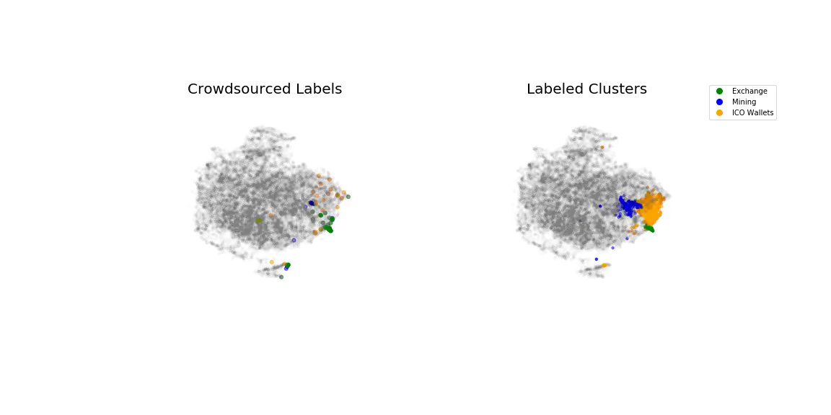

Slide 8
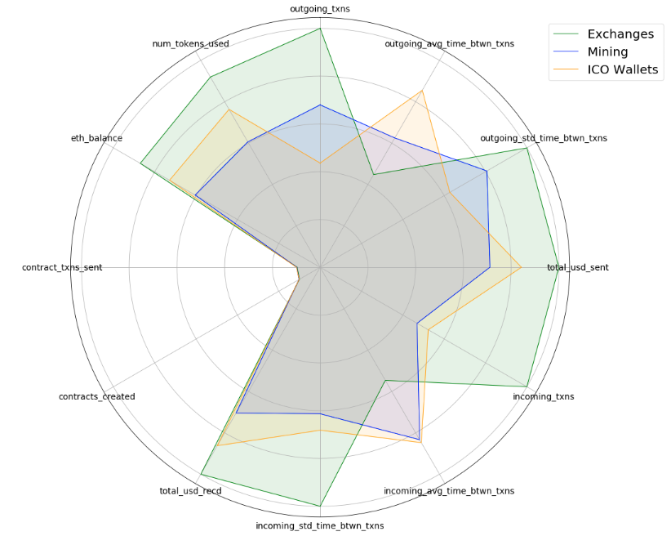
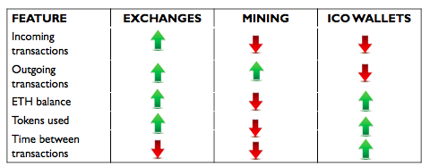

Slide 9
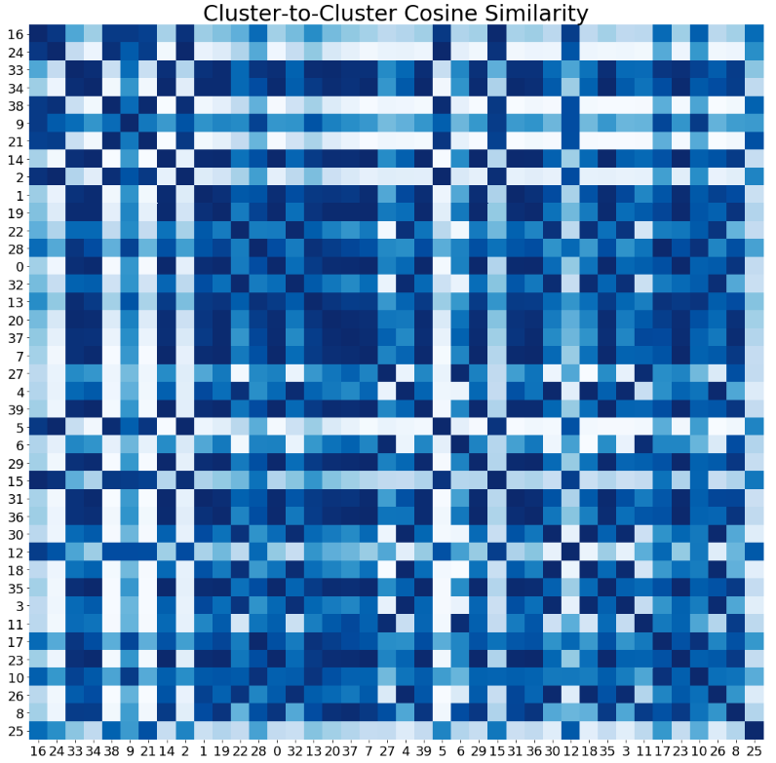
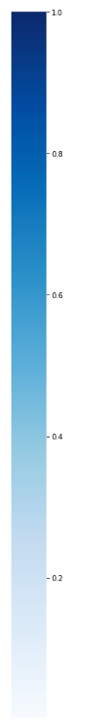

Slide 10
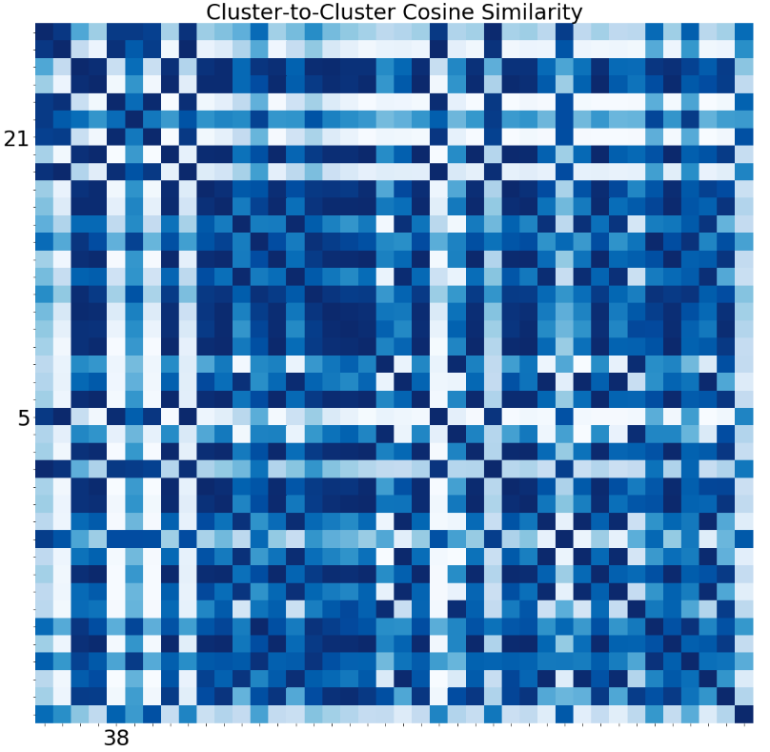
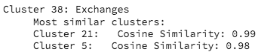
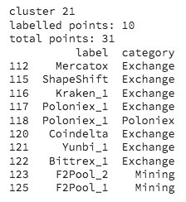
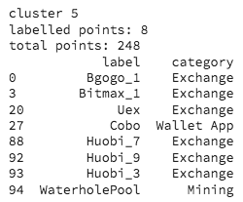
Token exchanges
Smart contract transactions
Smaller exchanges
Less frequent transactions

Slide 11
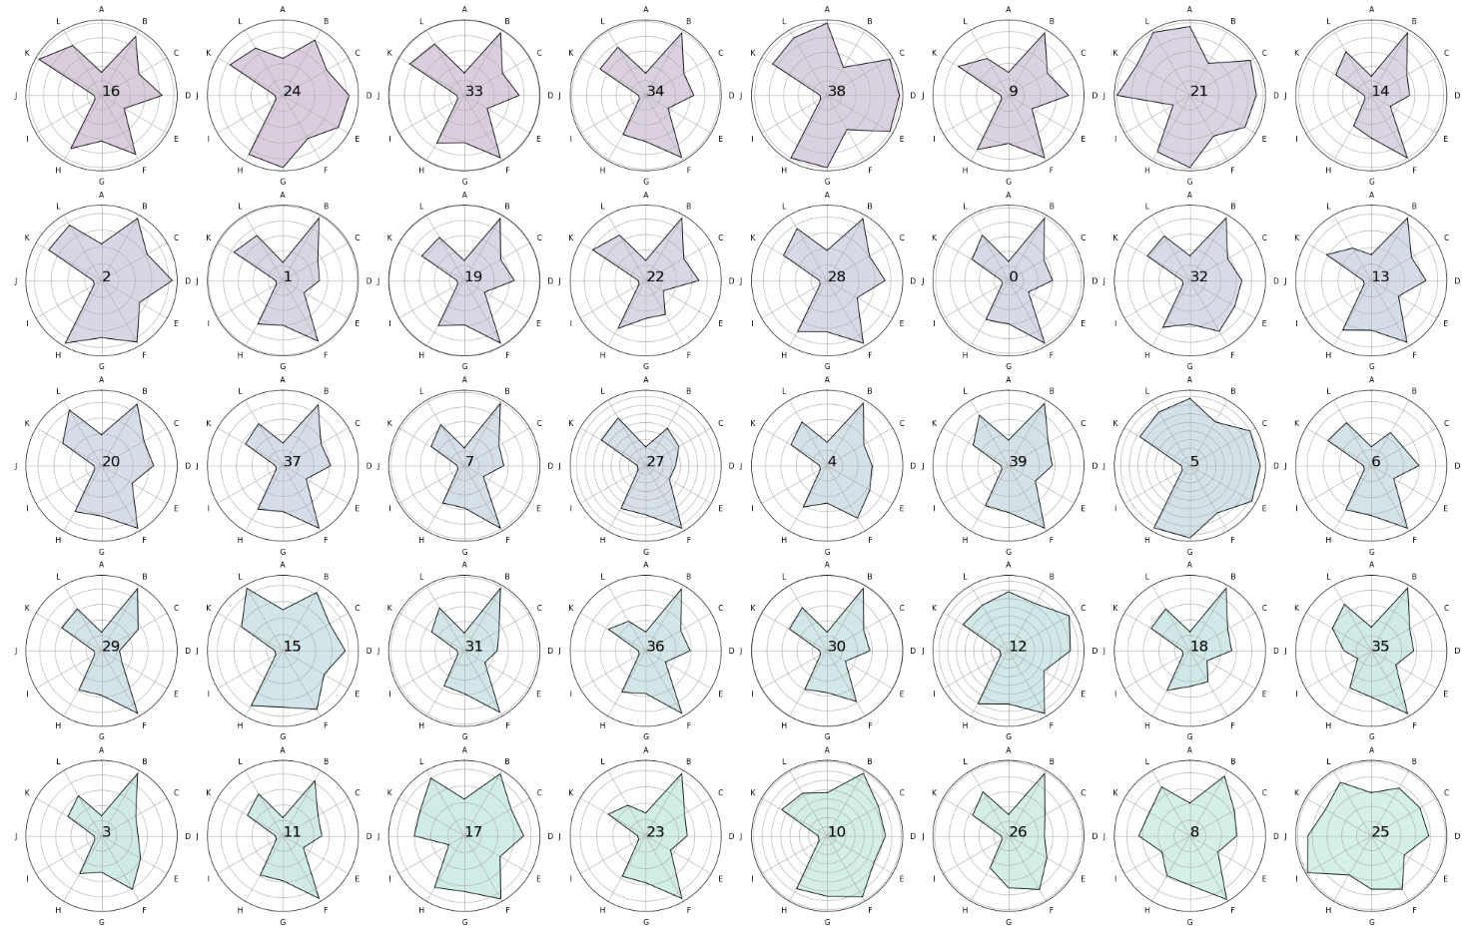
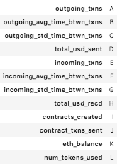
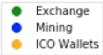

Slide 12
NEXT STEPS
Track movement of funds over time
Distinguish bots from humans
Create more smart contract features
Analyze network graph
Notes:
Who is transacting with who? Potential to track network activity

Slide 13
THANKS!

Slide 14
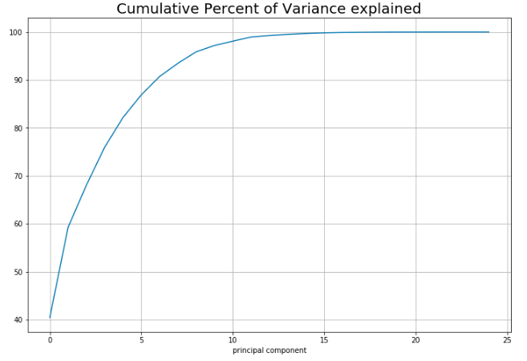
Dimensionality reduction

Slide 15
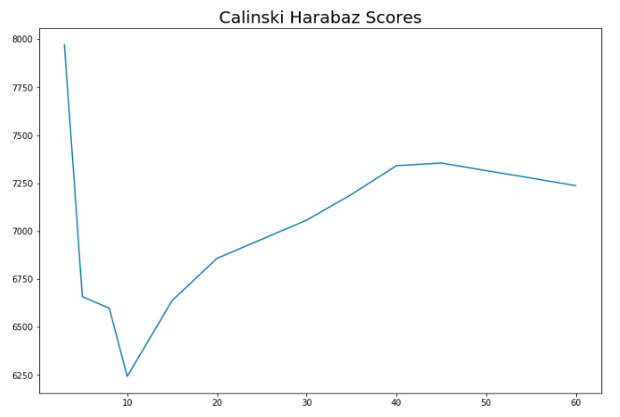
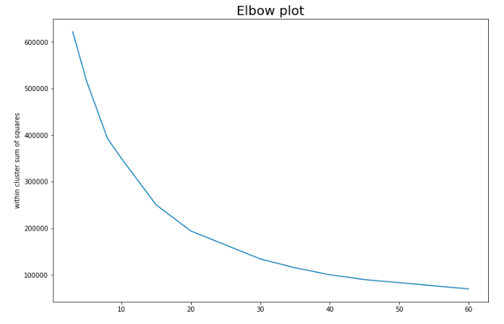
Optimal number of clusters is about 40

Slide 16
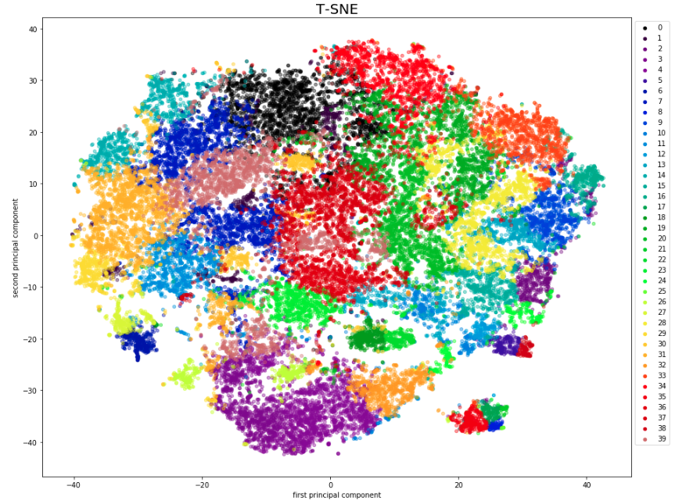

Slide 17
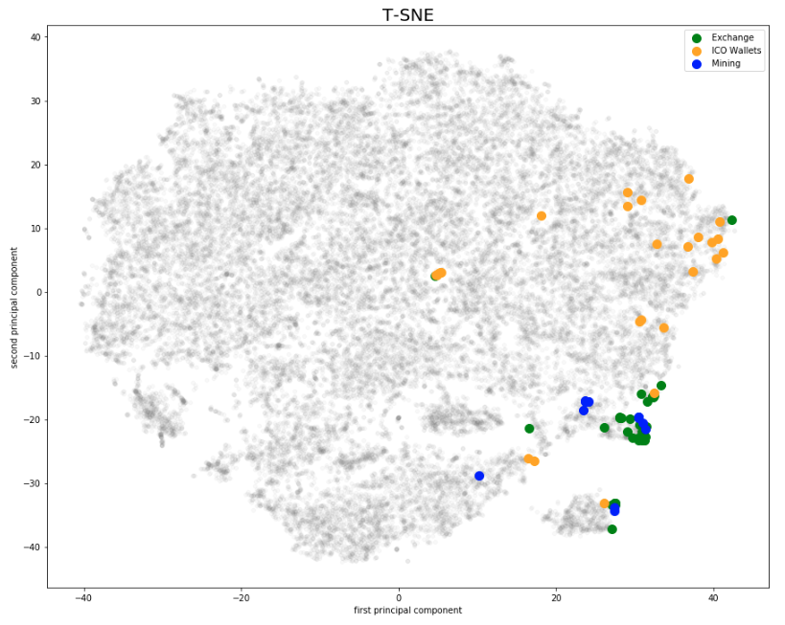

Slide 18
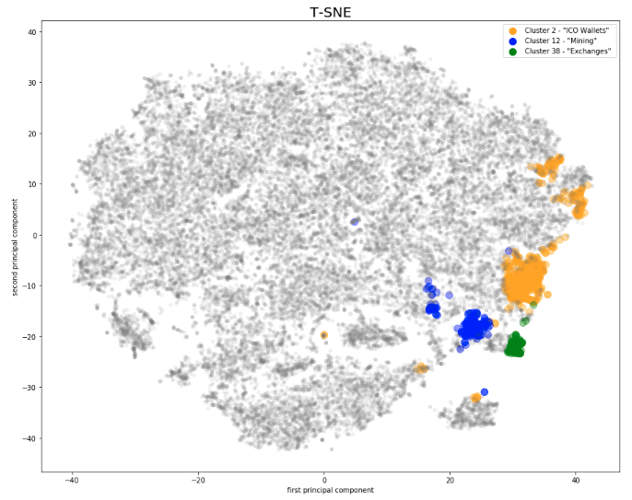
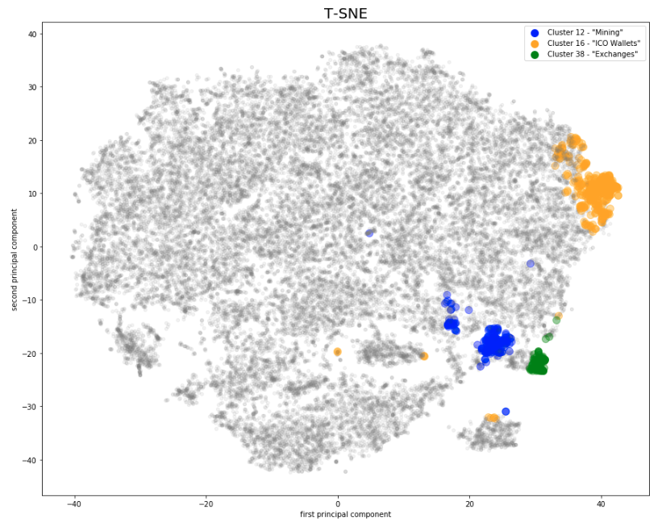
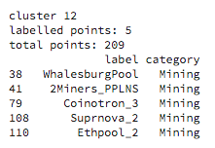
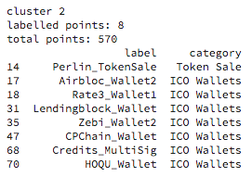
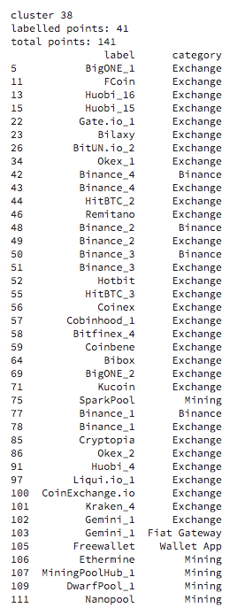

Slide 19
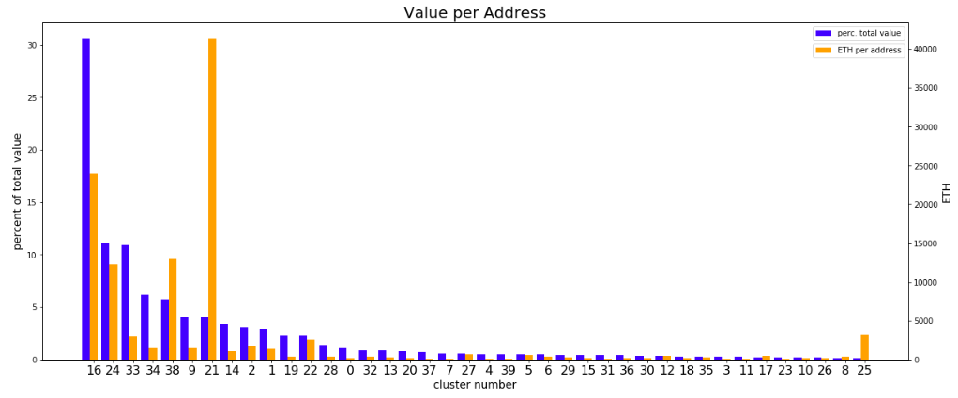

Slide 20
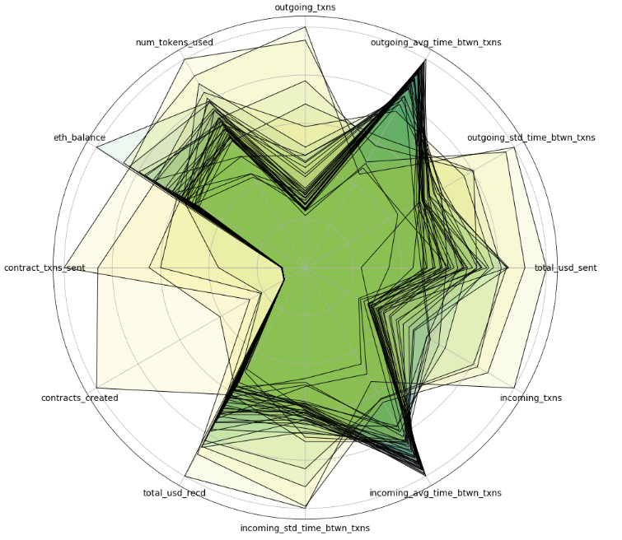

Slide 21
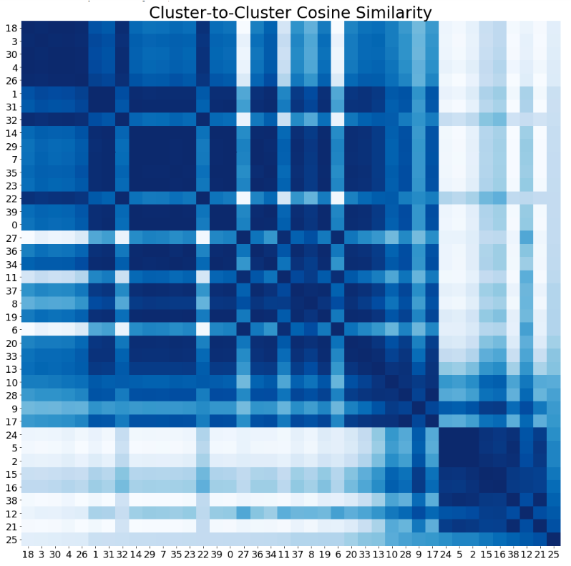

Slide 22
